Slide 1
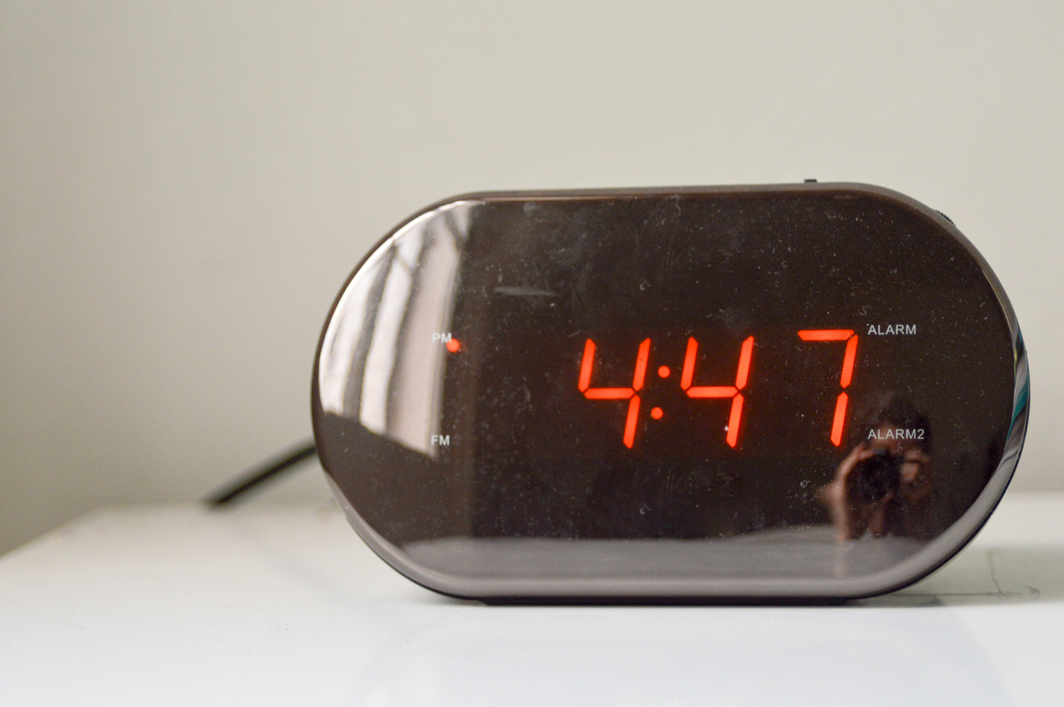
PRESENTED BY GROUP 3
DIGITAL
CLOCK
TÊN THÀNH VIÊN

Slide 2
TABLE OF CONTENTS
Introduction
Objective
Hardware
Firmware
Demo

Slide 3

INTRODUCTION
This project is a digital clock designed to combine both functionality and modern connectivity. It features an LCD display that shows the current date-time and temperature, making it a handy tool for everyday use. Beyond that, the clock can also display the date, time, and weather on a web server, allowing remote access to the information. Additionally, users can set alarms through a web interface, adding a convenient and interactive element to the system. This project blends hardware and software to create a practical, user-friendly device.

Slide 4

OBJECTIVE
Easy for managament time
Friendly desegin
Help user monitor the room temperature
Help user easily access the weather

Slide 5
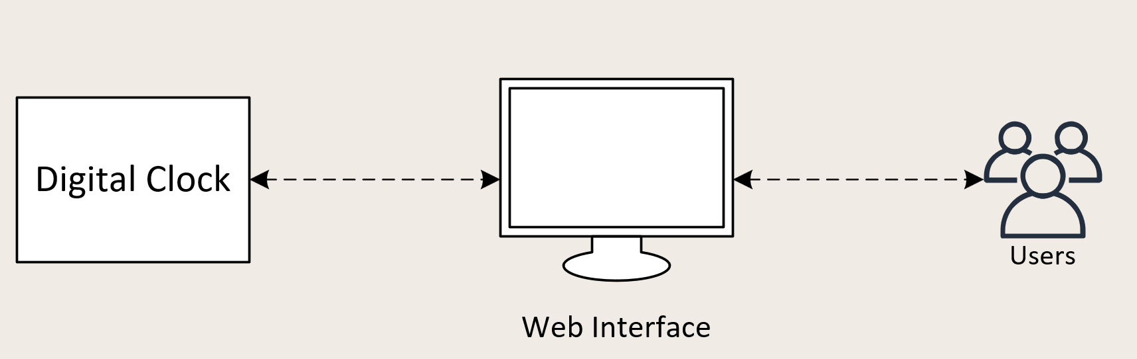
SYSTEM ARCHITECTURE

Slide 6
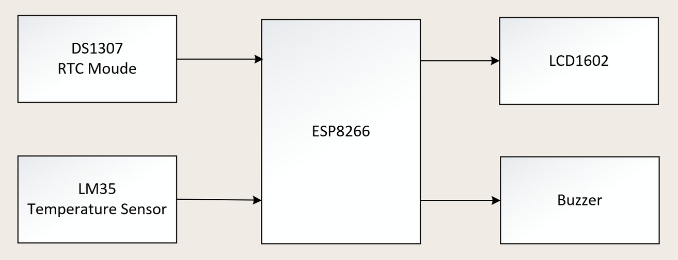
HARDWARE
Hardware Structure
Companents:
ESP8266
DS1307 RTC Module
LCD1602
LM35 Temperature Sensor
Buzzer
Function:
Display date-time and temperature
Alarm

Slide 7
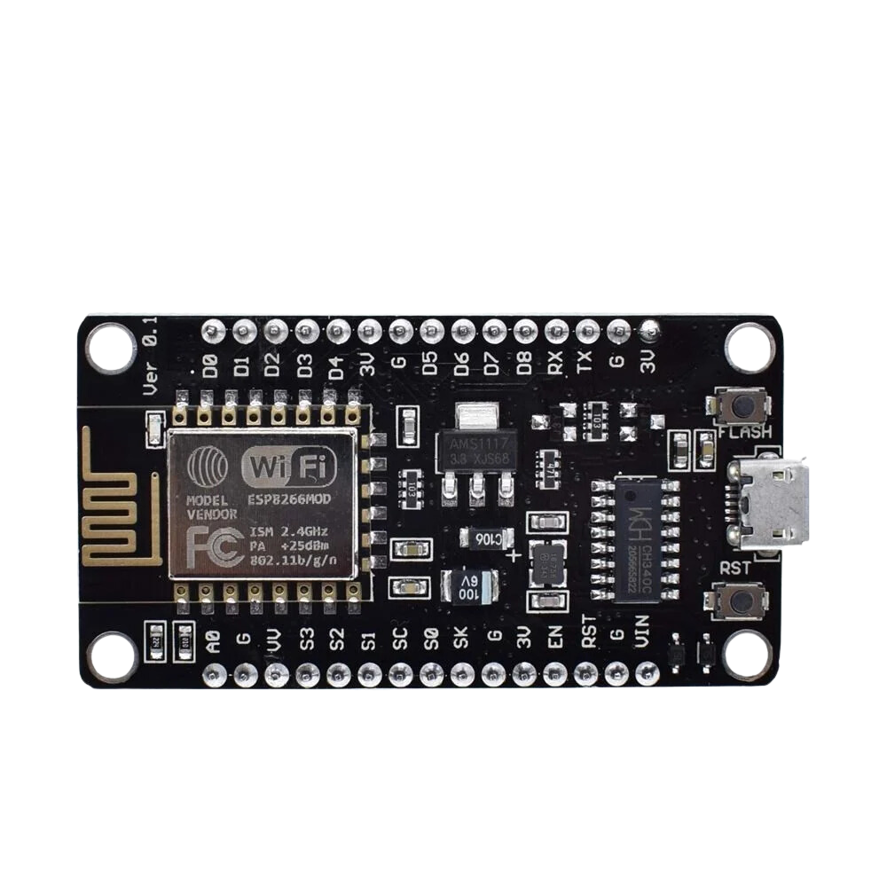
HARDWARE
Hardware Selection
Feature/Specification | ESP8266 Module
Microcontroller | Tensilica L106 (32-bit)
Operating Voltage | 3.3V
Clock Speed | 80 MHz (up to 160 MHz)
Digital I/O Pins | 17 (varies by model, limited PWM)
Analog Input Pins | 1 (10-bit ADC, 1V max)
Flash Memory | 1 MB (varies by model, up to 4 MB)
SRAM | 160 KB
EEPROM | None (uses Flash for storage)
Wi-Fi Connectivity | Built-in 802.11 b/g/n
Power Consumption | Lower (~20-70 mA, deep sleep <10 µA)
Programming | Arduino IDE, Lua, MicroPython
Cost | Low (~$2-5 depending on variant)

Slide 8
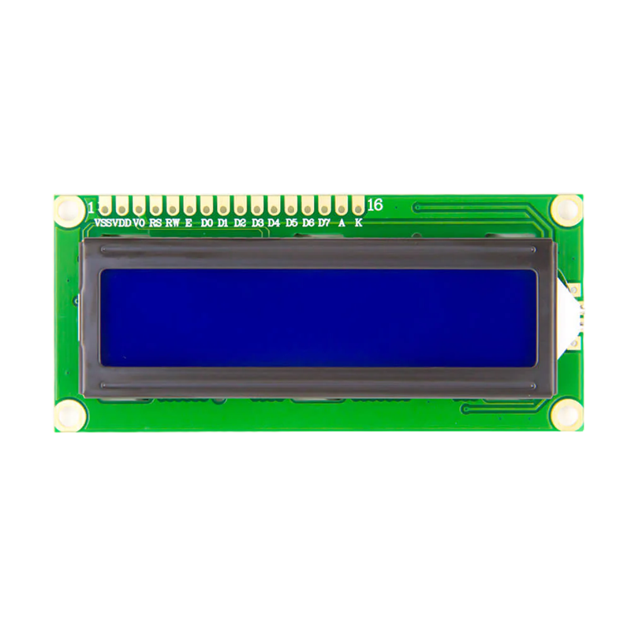
HARDWARE
Hardware Selection
Display Name | Character LCD (16x2)
Resolution | 16 characters x 2 rows
Display Technology | STN (Super-Twisted Nematic)
Operating Voltage | 5V (typical), some variants support 3.3V
Controller | HD44780 or compatible (e.g., ST7066)
Interface | Parallel (4-bit or 8-bit mode)
Backlight | LED (optional, typically blue or green)
Backlight Voltage | 5V (via resistor or current driver)
Contrast Adjustment | Via potentiometer (VO pin)
Operating Current | ~2 mA (without backlight), ~20-50 mA (with backlight)
Dimensions | 80 mm x 36 mm x 10 mm (typical)
Communication Pins | RS, RW, E, D0-D7 (8 data pins)
Power Consumption | Low (depends on backlight usage)
Cost | ~$2-5

Slide 9
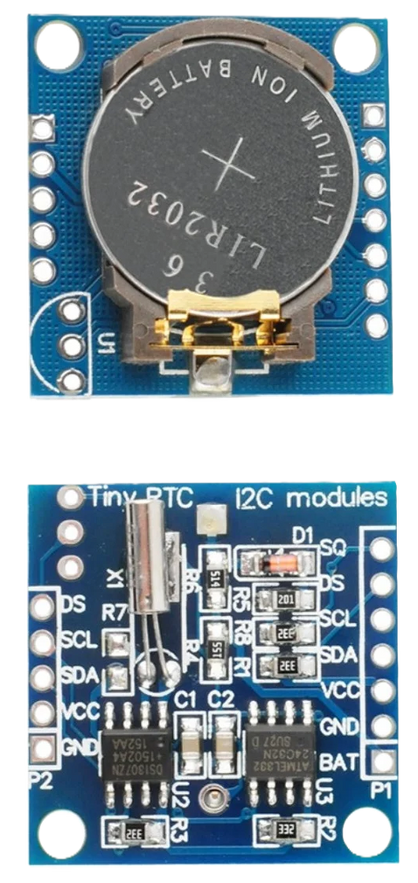
HARDWARE
Hardware Selection
Feature/Specification | RTC DS1307
Communication Protocol | I2C
Timekeeping Accuracy | ±2 minutes/month (crystal dependent)
Temperature Compensation | No
Operating Voltage | 5V (4.5V - 5.5V)
Backup Battery | Yes (CR2032 coin cell)
Temperature Range | 0°C to 70°C
Additional Features | 56 bytes SRAM, square wave output
Power Consumption | ~1.5 mA (active), 500 nA (battery mode)
Crystal | External 32.768 kHz required
Cost | Lower (~$1-2)

Slide 10
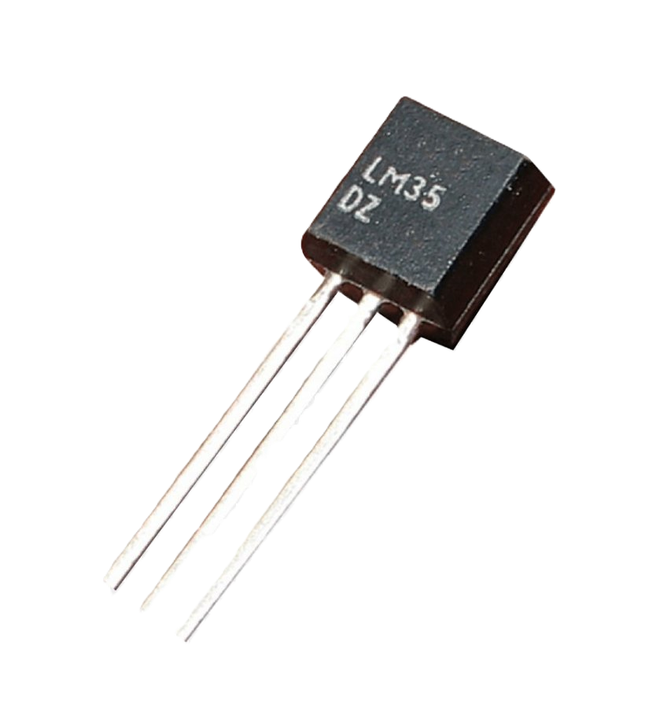
HARDWARE
Hardware Selection
Feature/Specification | LM35
Type | Analog Temperature Sensor
Temperature Range | -55°C to 150°C
Accuracy | ±0.5°C (at 25°C)
Output | Analog (10 mV/°C)
Humidity Measurement | None
Resolution | Continuous (analog)
Operating Voltage | 4V to 30V
Power Consumption | ~60 µA
Response Time | Fast (analog output)
Ease of Use | Requires ADC for microcontrollers
Cost | Moderate (~$1-2)

Slide 11
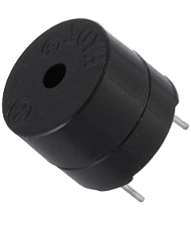
HARDWARE
Hardware Selection
Name | Active Buzzer (with internal oscillator)
Operating Voltage | 3.3V to 5V (common range)
Frequency | 2 kHz - 3 kHz (typically ~2300 Hz)
Sound Output | 70-85 dB at 10 cm (varies by model)
Current Consumption | 15-30 mA (at 5V, depending on model)
Control Method | Digital signal (HIGH/LOW to activate)
Pin Configuration | 2 pins (positive and ground)
Tone | Fixed (single tone, continuous beep)
Power Supply | DC (direct from microcontroller pin)
Cost | ~$0.5-1

Slide 12
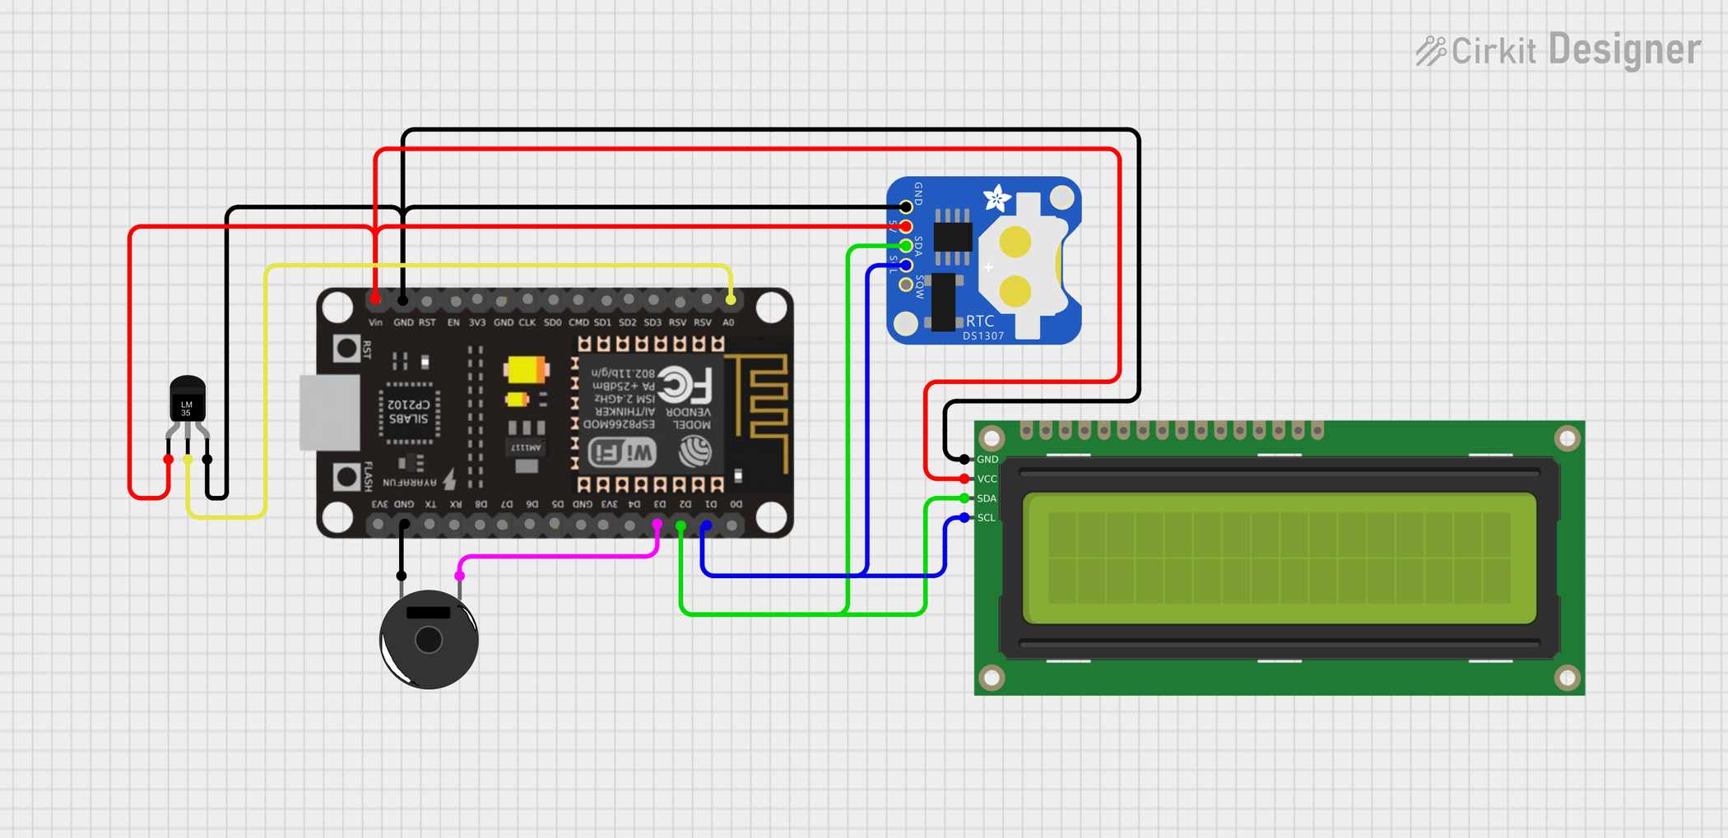
HARDWARE
Connection Diagram

Slide 13
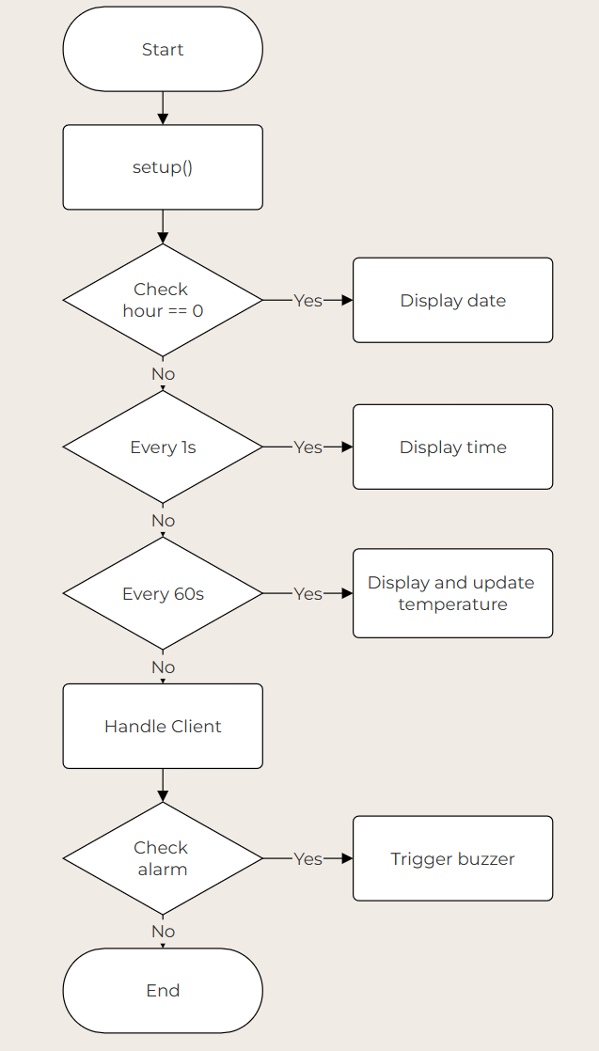
FIRMWARE
Flow chart

Slide 14
DEMO

Slide 15

THANK YOU VERY MUCH!

